Slide 1
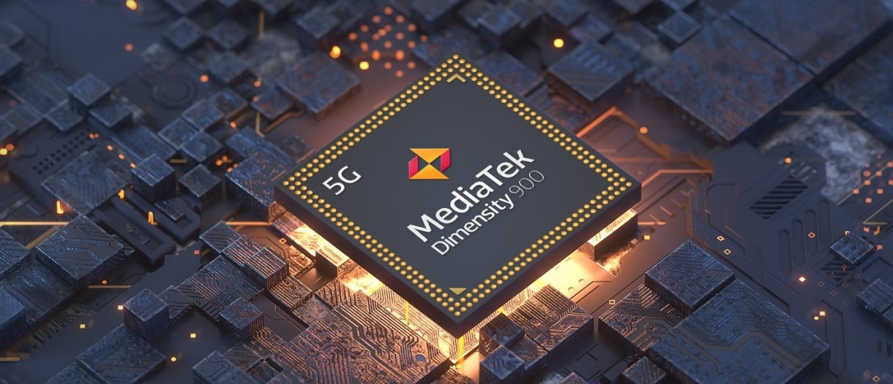
EG3611A Final Report
Liu Jingming
A0204685B

Slide 2
Overview
Introduction of Mediatek
Tasks given and work performed
Challenges and constrains encountered and solutions identified
Reflections on the internship
MediaTek | Tasks and work 1 | Tasks and work 2 | Challenges | Reflection

Slide 3
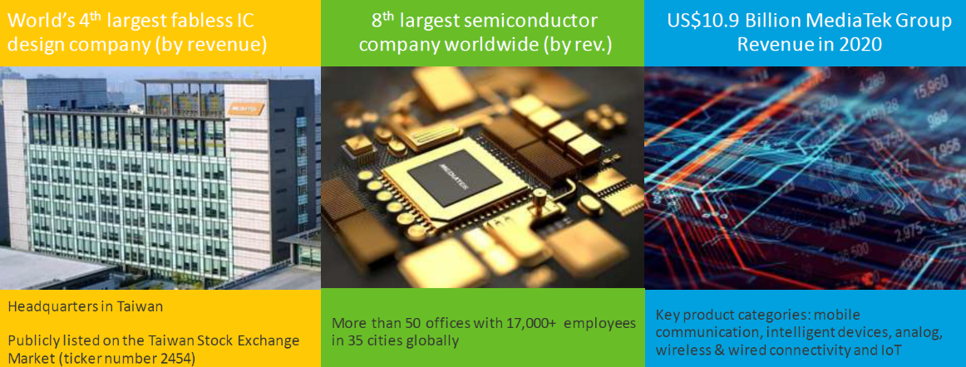
MediaTek at a Glance
MediaTek | Tasks and work 1 | Tasks and work 2 | Challenges | Reflection
Notes:
MediaTek Inc. is a Taiwanese fabless semiconductor company founded in 1997 and has more than 50 offices worldwide
It is the world’s 4th largest fabless IC design company and the 8th largest semiconductor company worldwide.
MediaTek’s technology is built with humans in mind to enhance and enrich life. Our company believes technology has to be great and great technology should be accessible to everyone.
MediaTek wants to make the world a more inclusive place, where smart and connected is an equal opportunity.

Slide 4
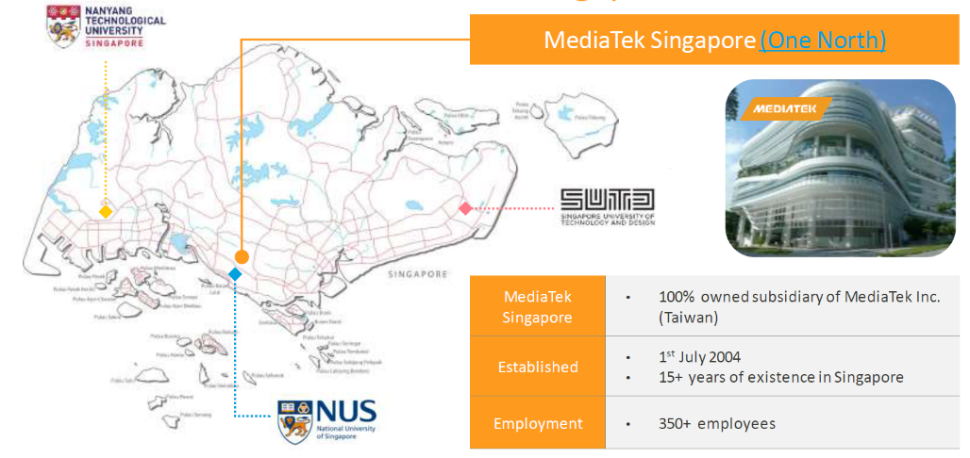
MediaTek Singapore
MediaTek | Tasks and work 1 | Tasks and work 2 | Challenges | Reflection
Notes:
Mediatek Singapore is located at One North. Established in July 2004, Mediatek Singapore is the regional headquarter for India, Singapore, Korea and Japan. There are over 350 employees in total.

Slide 5
Overview
Introduction of Mediatek
Tasks given and work performed
Challenges and constrains encountered and solutions identified
Reflections on the internship
MediaTek | Tasks and work 1 | Tasks and work 2 | Challenges | Reflection

Slide 6
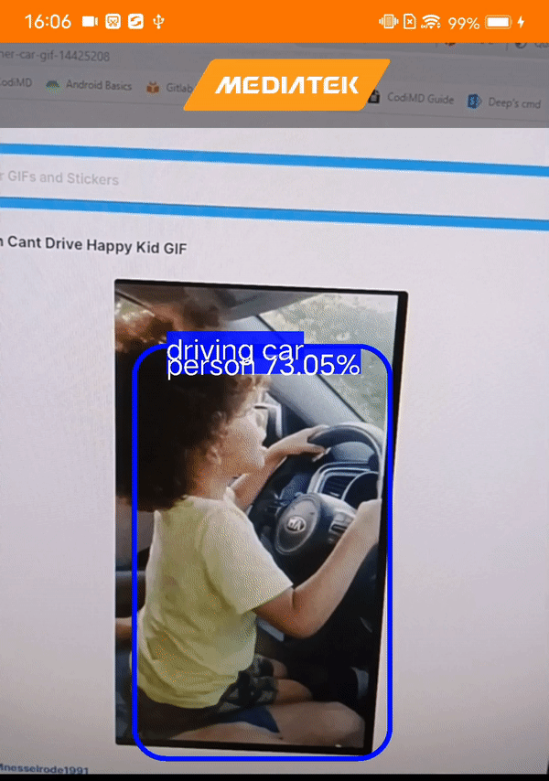
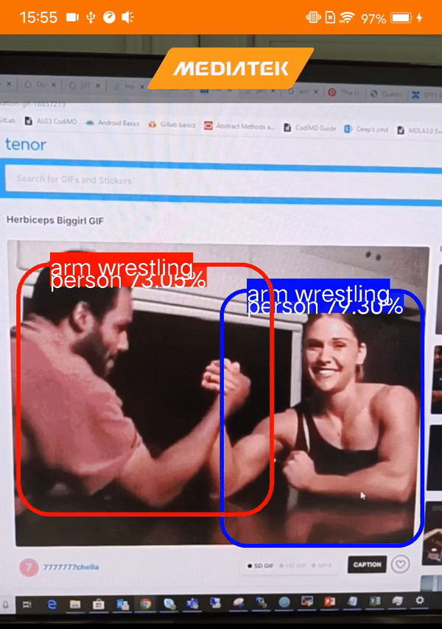
Research and skill learning
Project 1:
Action Recognition Android Application
Image preprocessing
Multithreading for action recognition
Action recognition TensorFlow Lite model
MediaTek | Tasks and work 1 | Tasks and work 2 | Challenges | Reflection
Notes:
During my internship, I have mainly participated in two projects.
The project that I did during the first half of my internship is the action recognition android application

Slide 7
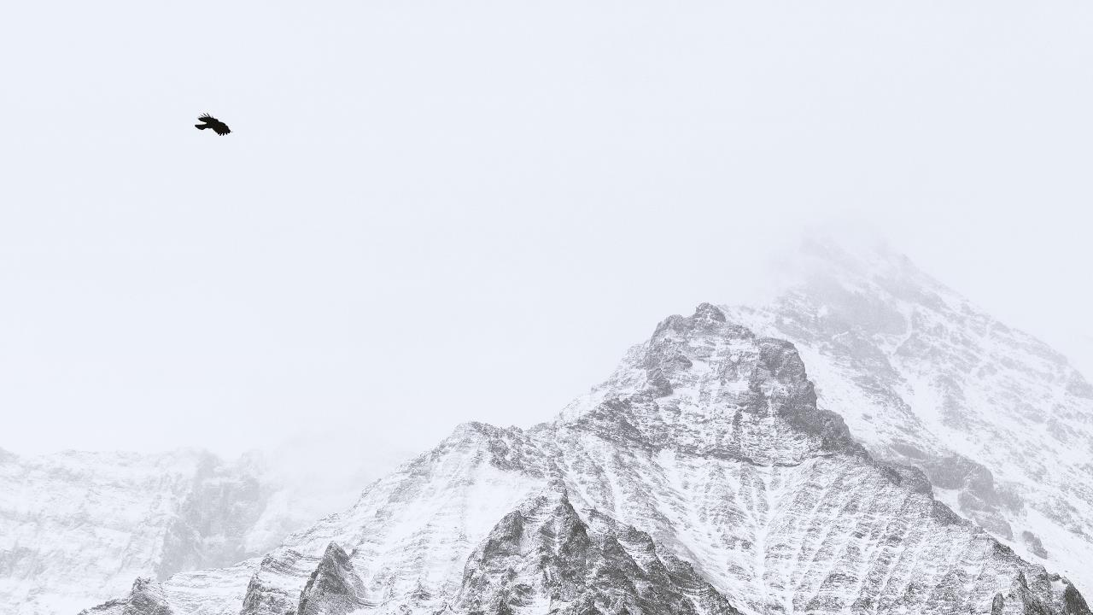
Research and skill learning (part 1)
TensorFlow Lite
Java Multithreading
SlowFast
Algorithm
Android
Studio
Modified an action recognition TensorFlow Lite Model for implementation on Android phone chips
Neural
Network
Implemented multithreading for action recognition part
Image preprocessing part of Action recognition Android App
Project, task or implementation
MediaTek | Tasks and work 1 | Tasks and work 2 | Challenges | Reflection
Notes:
animation

Slide 8
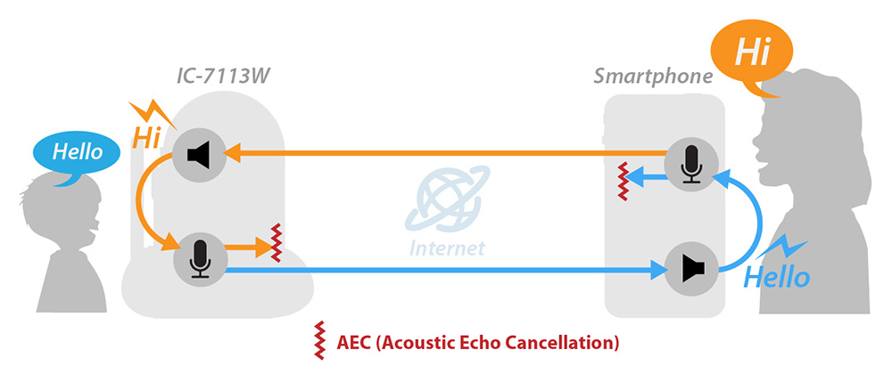
Research and skill learning
Project 2:
Acoustic Echo Cancellation model
Demo video for the application
Testing and training of existing models
Research on different testing frameworks
MediaTek | Tasks and work 1 | Tasks and work 2 | Challenges | Reflection
Notes:
The project that I did during the second half of my internship is the acoustic echo cancellation model

Slide 9
Research and skill learning (part 2)
Linux commands
Online courses
CS231n
Neural networks and deep learning
Research on AEC testing frameworks
Neural Network
Structure
Training
Testing and training of existing AEC models
Demo video for speech enhancement application
Project, task or implementation
MediaTek | Tasks and work 1 | Tasks and work 2 | Challenges | Reflection
Notes:
animation

Slide 10
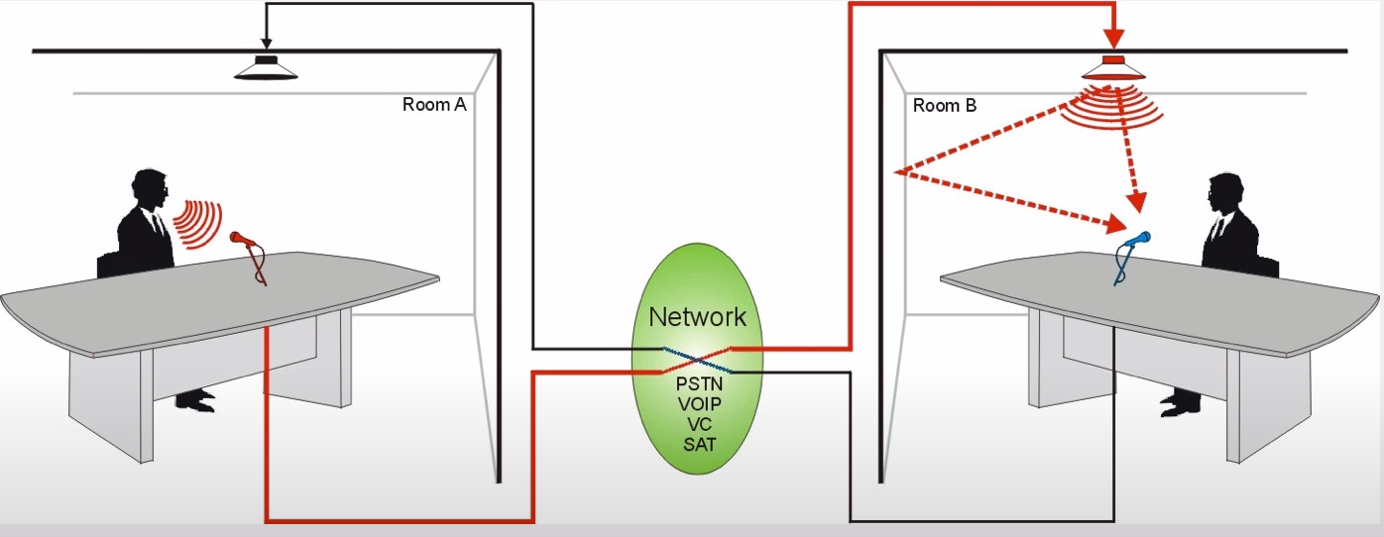
Acoustic Echo Cancellation
Far-end speech
Formation of Acoustic Echo
Near-end speech
MediaTek | Tasks and work 1 | Tasks and work 2 | Challenges | Reflection
Notes:
Acoustic echo refers to the same phenomenon that occurs when someone talks in a large, empty room. In the empty room, the actual sound waves are bouncing off of physical barriers. This also happens during digital phone calls. When you are in a call on speakerphone, the speech of the person you are talking to gets played out from the loudspeaker. This is referred to as “far-end speech.” Also, your own voice, is captured by the microphone and sent across the network to the other end of the call. This is referred to as “near-end speech.” However, the microphones don’t just capture the near-end speech, they can also capture the far-end speech. If the far-end speech is transmitted to the other side of the call, then the other person will hear their own voice, after a slight delay for network and processing. This is how acoustic echo happens.
It happens when your voice is sent through the outgoing stream, only to be picked up by a microphone on the other end and reflected back via the incoming stream. In simpler terms, imagine someone talking into their cell phone. Their voice transmits to the person they’re talking to, but the microphone of the receiver picks up the words that were said and sends it back to the person speaking. Depending on the echo interval, this can cause anything from a slight annoyance to a significant breakdown in communication. Usually, if the delay is 25 milliseconds or less, most people won’t even realize it. If the reverb reaches 55 milliseconds, it can sound like two people are saying the same thing at the same time. This echo is noticeable, but usually doesn’t significantly affect the user’s ability to communicate efficiently. Once the delay goes above 55 milliseconds, the echo interrupts the speaker, making it nearly impossible for them to keep their words straight. Having a conversation at this point is extremely difficult and, more often than not, leads to both parties prematurely ending the call.

Slide 11
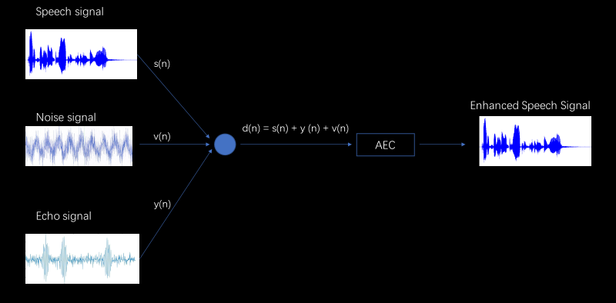
Acoustic Echo Cancellation
Acoustic Echo Cancellation
MediaTek | Tasks and work 1 | Tasks and work 2 | Challenges | Reflection
Notes:
There are mainly three voice signals being picked up by the microphone, the speech signal, noise signal and echo signal. We want to preserve the speech signal and remove other signals in order to generate a clean signal output.
Acoustic Echo Cancellation works by creating a filter that can remove the unwanted signals. It’s based on an adaptive algorithm that adapts this filter to model the acoustic path.

Slide 12
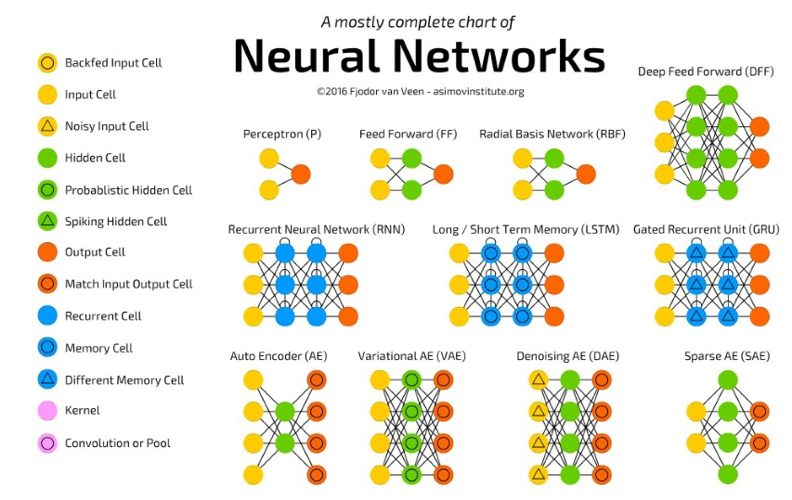
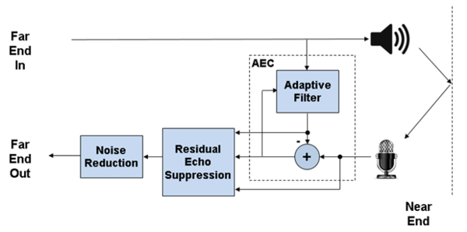
Acoustic Echo Cancellation
Linear adaptive filter
Neural network
MediaTek | Tasks and work 1 | Tasks and work 2 | Challenges | Reflection
Notes:
Acoustic echo cancellation (AEC) technology is a common addition to today’s conference phones. The technology recognizes and eliminates the echo as quickly as possible without affecting the audio quality. This concept may sound simple, but the actual process is challenging to achieve since you must take into account several factors. For example, the cancellation should continue to work even in situations where both sides of the conversation are talking at once or when there’s an abundance of background noise.
Traditionally, acoustic echo cancellation (AEC) used a linear adaptive filter to identify the acoustic impulse response between the microphone and the loudspeaker. However, when conventional methods encounter nonlinear conditions, the results of the processing are not good enough. Our practice utilizes the advantages of deep-learning techniques, which are beneficial for nonlinear processings.

Slide 13
Project, task or implementation
Demo video for speech enhancement application
Introduction of AEC and Speech Enhancement technology
Live demonstration of the application
MediaTek | Tasks and work 1 | Tasks and work 2 | Challenges | Reflection

Slide 14
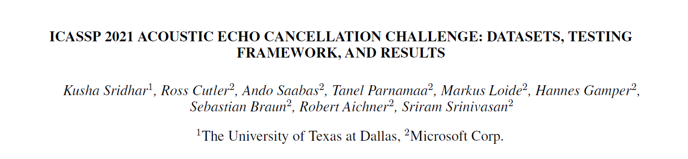
Research on AEC testing frameworks
Digital signal processing (DSP)
Supervised learning algorithms for AEC
Adaptive filters
+
Recurrent neural networks
MediaTek | Tasks and work 1 | Tasks and work 2 | Challenges | Reflection
Notes:
I did a research on the AEC testing frameworks, based on the paper acoustic echo cancellation challenge: datasets, testing framework and results
AEC technology has developed form the traditional digital signal processing to supervised learning algorithms, and is now using adaptive filters together with recurrent neural networks
However, most of the conventional objective metrics for speech quality evaluation are not suitable for the evaluation of AEC models. Hence this paper aims to provide a more accurate evaluation framework for AEC

Slide 15
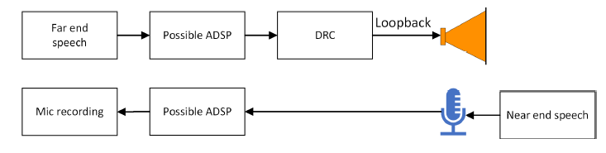
Research on AEC testing frameworks
Training dataset (real dataset) | crowdsourcing effort 2,500 different real environments, audio devices, and human speakers
Training dataset (synthetic dataset) | 10,000 synthetic scenarios single talk double talk near end noise far end noise various nonlinear distortion scenarios
Test set | Clean Noisy
MediaTek | Tasks and work 1 | Tasks and work 2 | Challenges | Reflection
Notes:
Captured using a large-scale crowdsourcing effort
Consists of more than 2,500 different real environments, audio devices, and human speakers

Slide 16
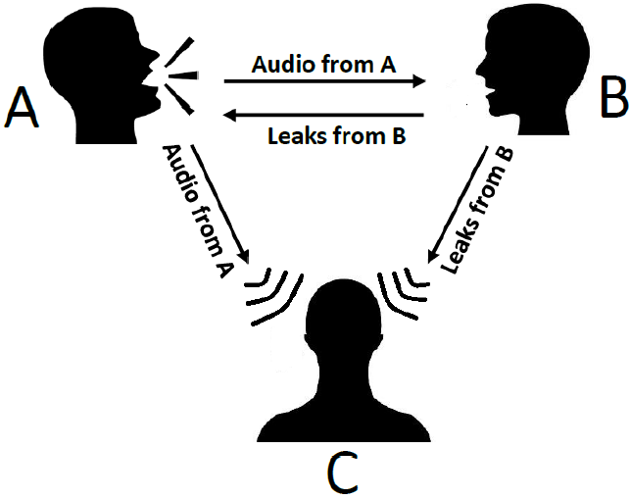
Research on AEC testing frameworks
P.808 Toolkit
Different combinations of single- and multi-scale ACR ratings
Scenario | Rating criteria
Near end single talk | overall quality
Far end single talk | echo annoyance scale
Double talk | echo annoyance + impairments of other degradations
MediaTek | Tasks and work 1 | Tasks and work 2 | Challenges | Reflection

Slide 17
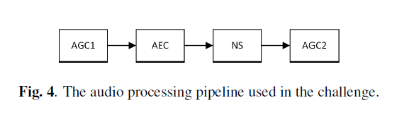
Research on AEC testing frameworks
P.808 Toolkit
Audio processing pipeline
AGC1 | Traditional automatic gain control → Target a speech level of -24 dBFS
AEC | Model to be tested
NS (noise suppressor) | Reduce stationary noise
AGC2 | Ensure speech level is still -24 dBFS
MediaTek | Tasks and work 1 | Tasks and work 2 | Challenges | Reflection

Slide 18
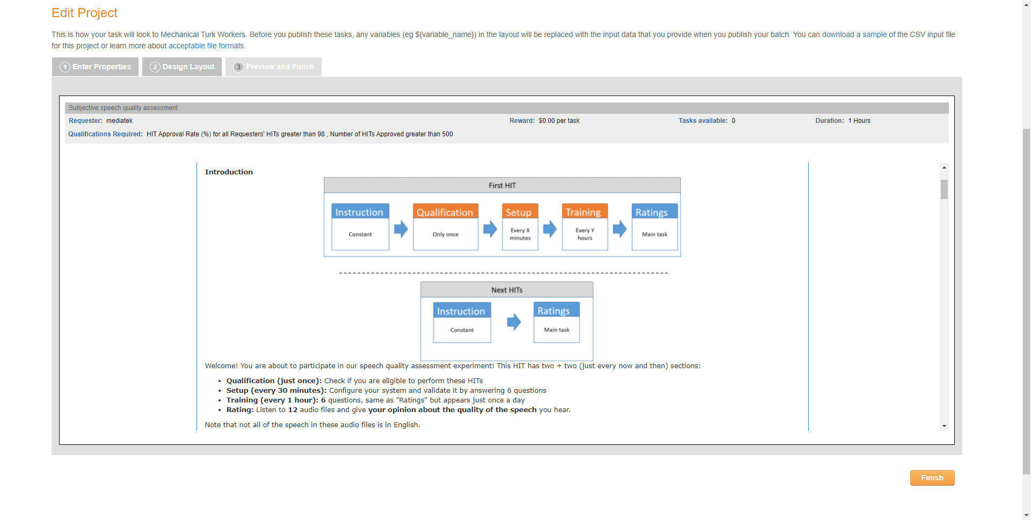
Research on AEC testing frameworks
MediaTek | Tasks and work 1 | Tasks and work 2 | Challenges | Reflection

Slide 19
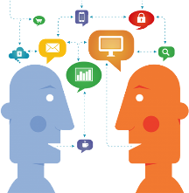


Objectives accomplished
Work knowledge
Communication skills
Technical elective
MediaTek | Tasks and work 1 | Tasks and work 2 | Challenges | Reflection
Notes:
Gained work knowledge on Android application development and the training and testing of machine learning models
I have also improved my communication skills through the weekly meetings and collaboration with my colleagues
Have a clearer idea of my future technical elective focus area

Slide 20
Challenges and constraints encountered and solutions identified
Challenges | Solutions
Transition from school projects to work tasks | Self-learning Make use of online resources Advice from supervisors and colleagues
MediaTek | Tasks and work 1 | Tasks and work 2 | Challenges | Reflection
Notes:
Table
Challenge solution/how to overcome

Slide 21
Challenges and constraints encountered and solutions identified
Challenges | Solutions
Transition from school projects to work tasks | Self-learning Make use of online resources Advice from supervisors and colleagues
Reading and understanding of project code | Start from the main file Understand the overall flow and structure of the project first Then take a detailed look at the functions used
MediaTek | Tasks and work 1 | Tasks and work 2 | Challenges | Reflection
Notes:
Table
Challenge solution/how to overcome

Slide 22
Challenges and constraints encountered, and solutions identified
Challenges | Solutions
Transition from school projects to work tasks | Self-learning Make use of online resources Advice from supervisors and colleagues
Reading and understanding of project code | Understand the purpose of program Start from the main file Understand the overall flow and structure of the project first Then take a detailed look at the functions used
Trouble-shooting and bug fixing | Active communication with colleagues List out all the possible reasons, and solve one at a time
MediaTek | Tasks and work 1 | Tasks and work 2 | Challenges | Reflection
Notes:
Table
Challenge solution/how to overcome

Slide 23
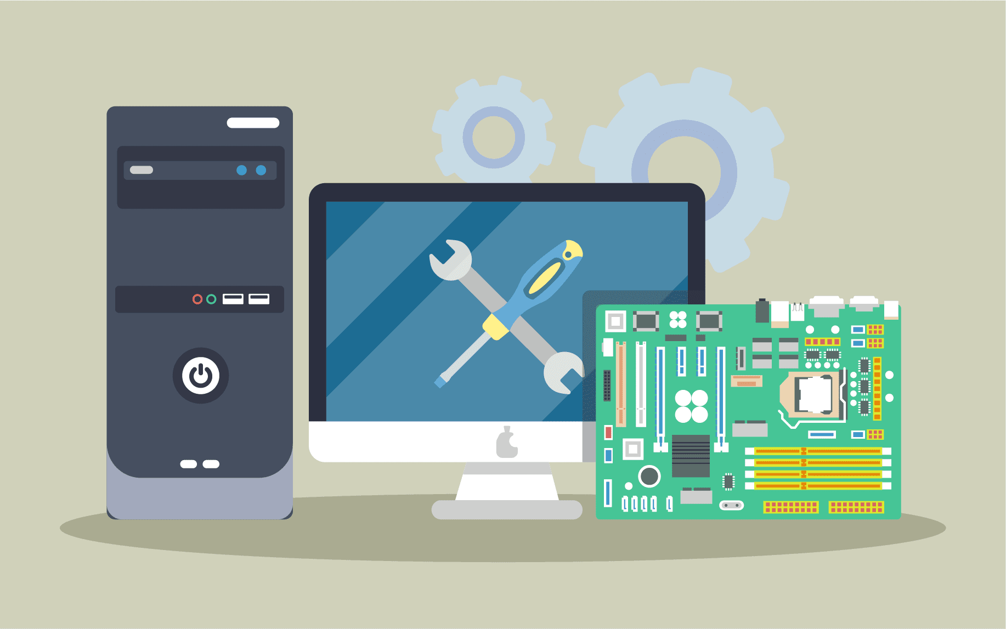
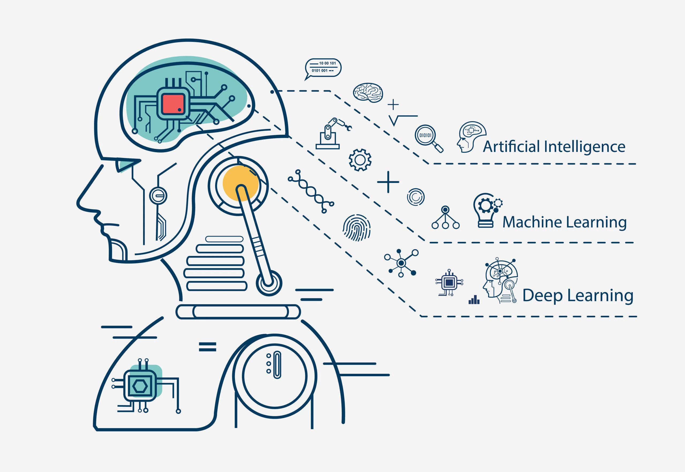
Application to future projects and employment opportunities
MediaTek | Tasks and work 1 | Tasks and work 2 | Challenges | Reflection
Notes:
The internship has not only improved my programming and communication skills, but also gives me inspirations about my future academic and career paths. Through this attachment, I had a better understanding of the computer engineering industry. It also provided an opportunity to learn more about machine learning and neural networks.

Slide 24



Reflections on the internship
Decision making
Constantly learning
Active communication
MediaTek | Tasks and work 1 | Tasks and work 2 | Challenges | Reflection
Notes:
During the past three months of my internship, I have three main reflections.
Firstly, it is important that we make thorough analysis of the needs and requirements of the project before we make a decision. During work, many factors contribute to final product, and we need to analyze the weight of different factors and focus on the most important ones.
Secondly, we need to constantly learn new concepts and skills. It is important that we can make use of online resources to learn and upgrade our skills.
Lastly, active communication with colleagues and supervisors is also important. In this way, we can work more efficiently and learn from each other.

Slide 25
Thank you!
MediaTek | Tasks and work 1 | Tasks and work 2 | Challenges | Reflection

